Slide 1
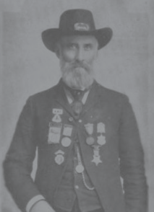
Did Civil War Veterans Have PTSD?
Larry M. Logue
Peter Blanck

Slide 2

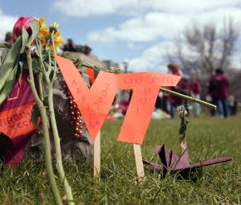
Post-traumatic stress disorder
One night in December, Ms. Anderson crumpled to the floor of her apartment and sobbed for a long time. She Googled "post-traumatic stress disorder" and recognized the symptoms.

Slide 3
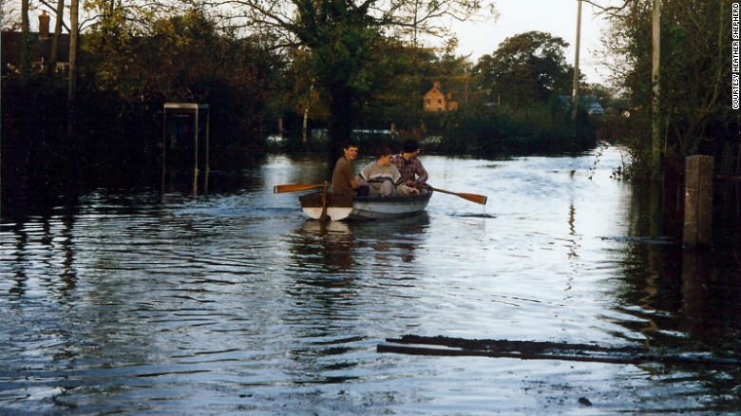
Depression, anxiety, PTSD: The mental impact of climate change
Among direct flood victims, 20% had been diagnosed with depression, 28.3% with anxiety and 36% with post-traumatic stress disorder.

Slide 4
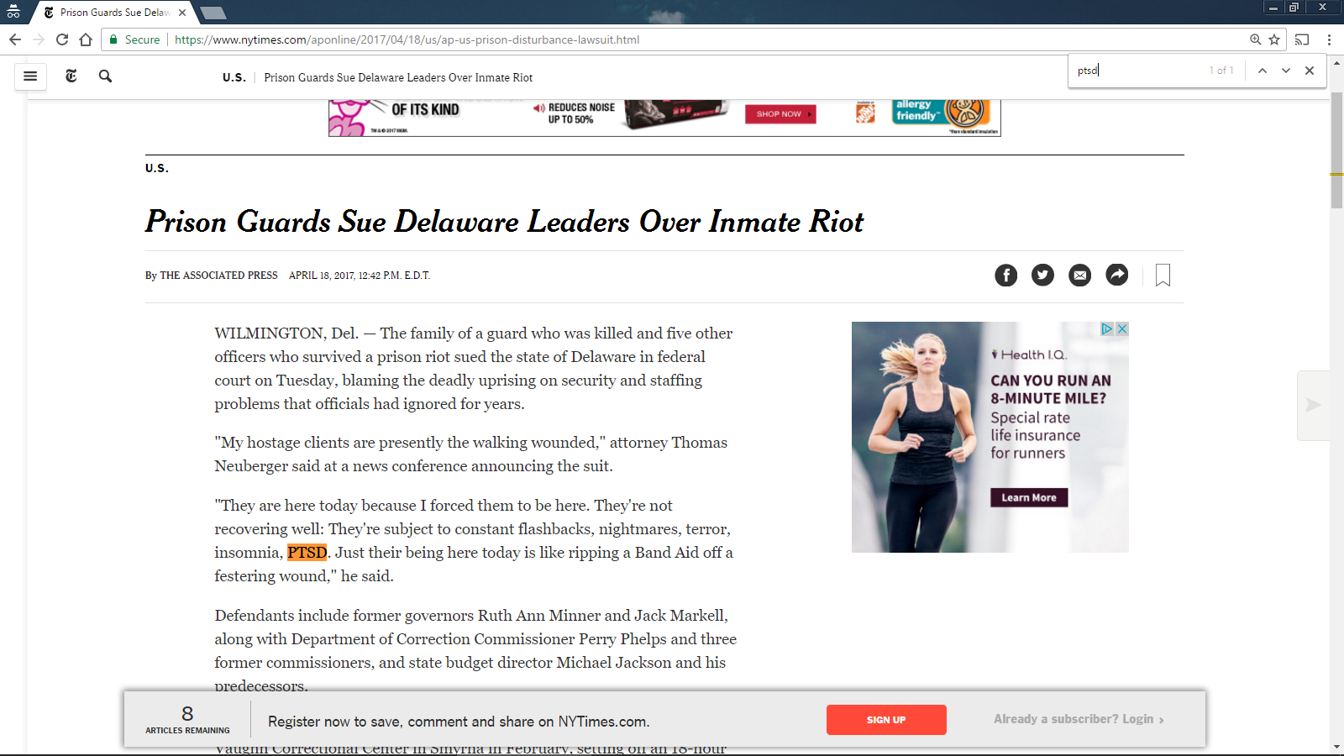
Prison Guards Sue Delaware Leaders Over Inmate Riot

Slide 5
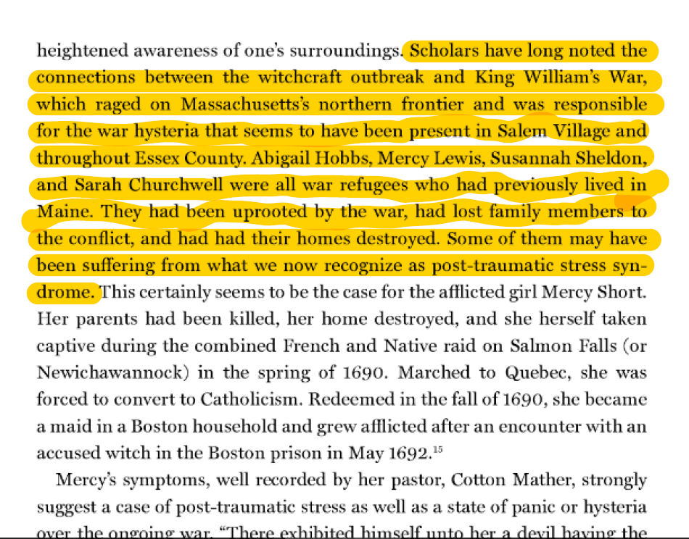
Scholars have long noted the connections between the witchcraft outbreak and King William's War

Slide 6
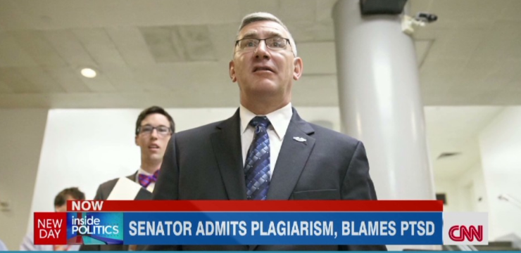
Senator admits plagiarism, blames PTSD

Slide 7
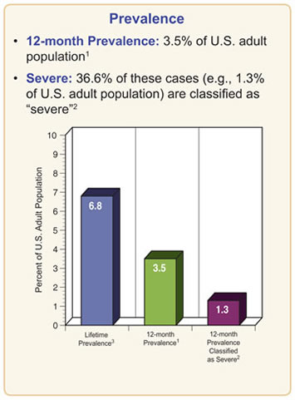
Post-Traumatic Stress Disorder Among Adults
Source: National Institute of Mental Health, Health and Education Statistics

Slide 8
PTSD and the Civil War
PTSD and the Civil War
BY SARAH HANDLEY-COUSINS AUGUST 13, 2014 12:15 PM
Daniel Folsom, a tinsmith from northern New York, enlisted in the Union Army just days after the fall of Fort Sumter. His exemplary service through years of long marches and hard battles led to two promotions, but during the Battle of Fredericksburg in late 1862, something changed. Folsom seemed uneasy. He was still troubled months later when the regiment mustered out. He returned home, opened his own tin shop and tried to focus on work.
Folsom was not alone: Tens of thousands of veterans damaged by the war had to learn how to live and work with their wounded bodies. In much the same way, Folsom had to adapt to life with a wounded mind. His illness – what today we would likely call post-traumatic stress disorder – had damaged his reputation, but he might be able to prove himself through clean living and dedication.

Slide 9
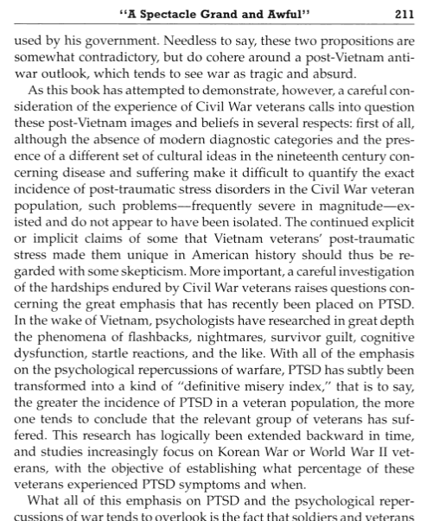
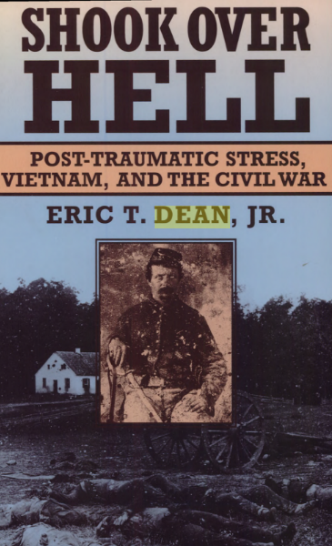
A spectacle Grand and Awful

Slide 10
Go to Your Gawd Like a Soldier
For example, Michael Schaefer’s work arguing for the prevalence of PTSD among Civil War veterans cites a single, nonscholarly article from the New Yorker as the whole intellectual underpinning for an argument that trauma must have existed among Civil War veterans due to a sociobiological inhibition against killing, despite the relative paucity of source material supporting such an assertion.31 In a similar vein, Diane Sommerville contends that “even a cursory view of sources shows what is certainly obvious to anyone with twenty-first-century sensibilities: that Confederate soldiers greatly suffered from the trauma of war.”32 This is not to deny that Sommerville’s subjects suffered—they clearly did—but her piece also points out that some of that suffering arose from postwar struggles and dislocations. Disaggregating causes (never mind assessing how representative Sommerville’s subjects’ experiences were in the post–Civil War South) requires more theoretical subtlety than assuming the validity of PTSD as a timeless diagnosis.33 Neither Schaefer nor Sommerville, nor the other historians—Eric Dean, Gerald Linderman, Michael C. C. Adams, and Drew Faust—who have written more cautiously about the possibility of widespread psychological trauma among Civil War veterans have engaged the multifaceted theoretical literature on trauma mentioned above, despite the complexity of the subject and its contingent history.34 Worse yet, historians who overemphasize trauma among Civil War veterans risk applying our present, contingent, and arguably dogmatic ideas about human consciousness to historical actors who do not share our assumptions about human experience and personality.35 James Marten expresses far less skepticism than I do about PTSD’s usefulness as an analytical category, but he also rightly tells us that “we know little about the interior lives of veterans.”36 I would go farther than other historians and argue that that lack of knowledge stems not simply from a scarcity of source material but from profound differences between our conceptions of memory and self and those of our historical subjects. We can bridge that chasm with care and circumspection, but it will require a more interdisciplinary approach than that heretofore used by scholars of the Civil War era.37
Wayne W. Hsieh, “‘Go to Your Gawd Like a Soldier’: Transnational Reflections on Veteranhood,” Journal of the Civil War Era 5 (2015), 551-577.

Slide 11
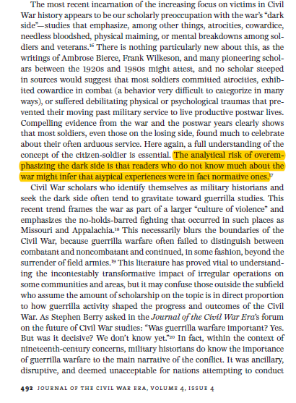
Coming to Terms with Civil War Military History
Gary W. Gallagher and Kathryn Shively Meier, “Coming to Terms with Civil War Military History,” Journal of the
Civil War Era 4 (2014), 487-508.

Slide 12
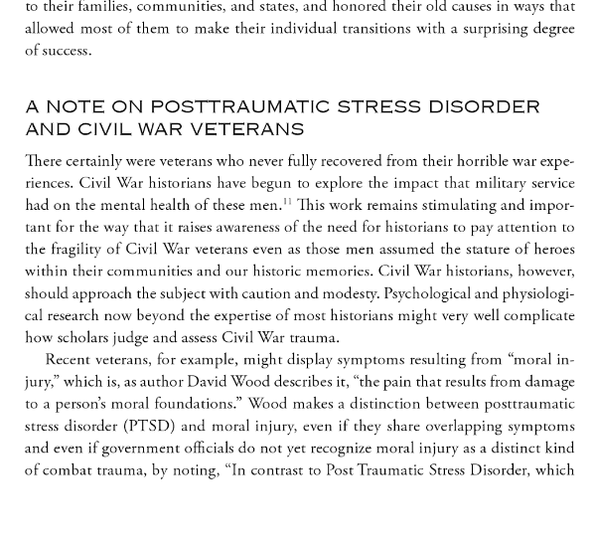
Veterans North and South: The Transition from Soldier to
Civilian after the American Civil War
Paul A. Cimbala, Veterans North and South: The Transition from Soldier to
Civilian after the American Civil War (Santa Barbara, Calif.: Praeger, 2015)

Slide 13
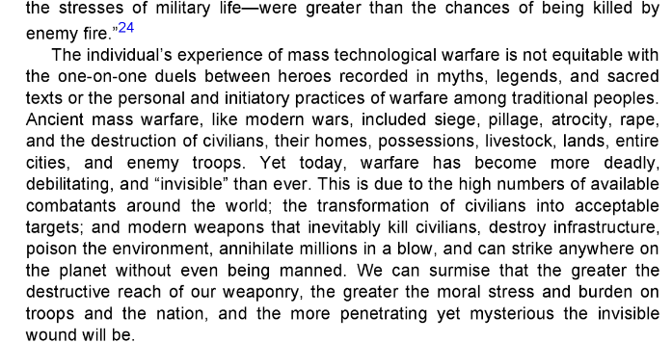
Restoring the Soul after War
Edward Tick, Warrior’s Return: Restoring the Soul after War
(Boulder, Colo.: Sounds True Publishing, 2014)

Slide 14
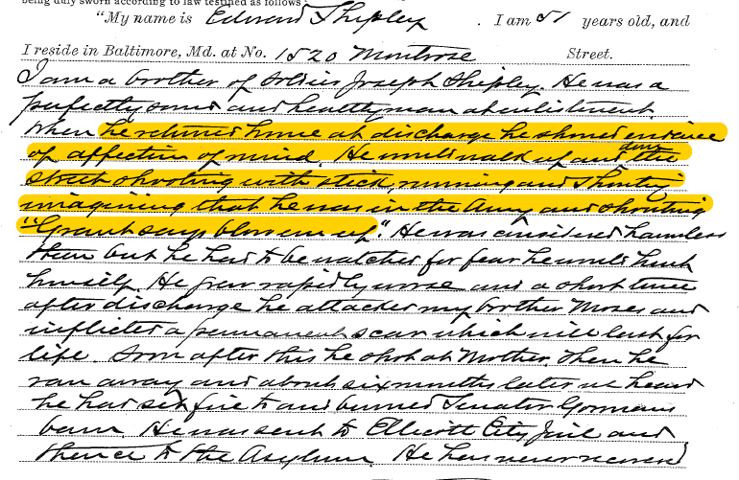

Slide 15
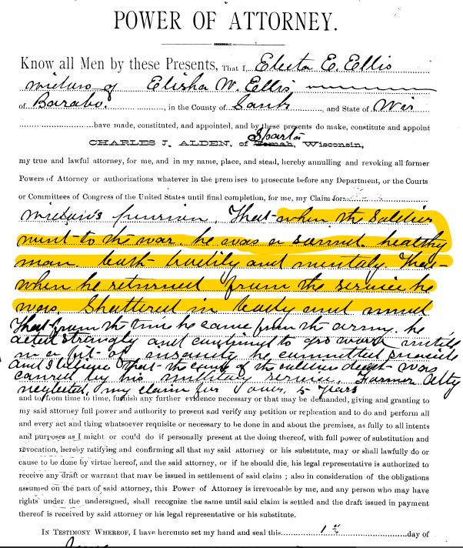
Power of Attorney

Slide 16
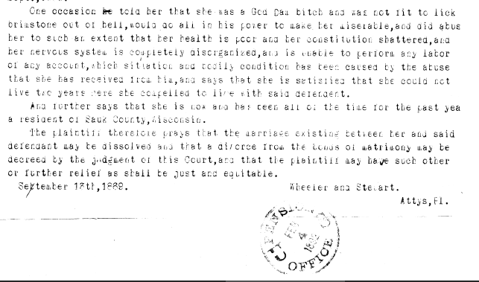

Slide 17
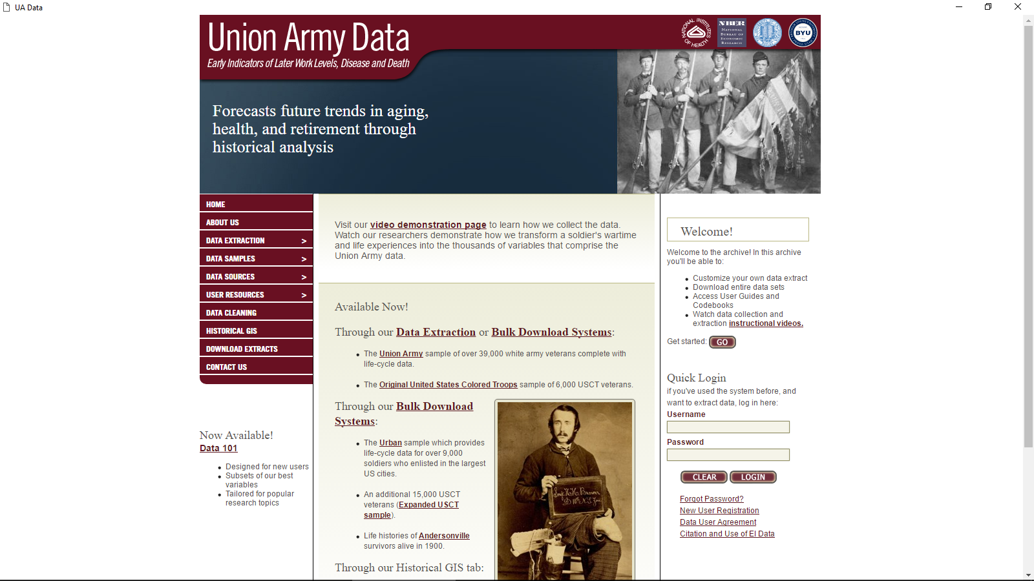
Union Army Data website

Slide 18
Men reported as “insane,” 1880 U.S. Censusn reported
Table 1: Men reported as “insane,” 1880 U.S. Censusn reported as “insane,” 1880 U.S. Census
 | Number insane per 10,000
Veterans in EI Urban sample¹ | 40
All white men 30-60² | 35
¹Robert W. Fogel et al., The Impact of Urban Disparities on Aging and Mortality [machine-readable database] (Chicago: Center for Population Economics, University of Chicago, 2015).
²Steven Ruggles et al., Integrated Public Use Microdata Series: Version 6.0 [machine-readable database] (Minneapolis: University of Minnesota, 2015). Rates adjusted for age distributions.

Slide 19
Men reported as “insane,” 1880 U.S. Census and pension examinationsn
Table 2: Men reported as “insane,” 1880 U.S. Census and pension examinationsn reported as “insane,” 1880 U.S. Census
 | Number insane per 10,000
Veterans in EI Urban sample (including pension examinations)¹ | 67
All white men 30-60² | 35
¹Robert W. Fogel et al., The Impact of Urban Disparities on Aging and Mortality [machine-readable database] (Chicago: Center for Population Economics, University of Chicago, 2015).
²Steven Ruggles et al., Integrated Public Use Microdata Series: Version 6.0 [machine-readable database] (Minneapolis: University of Minnesota, 2015). Rates adjusted for age distributions.

Slide 20
Buddy Check on 22!’ Veterans Use Social Media to Fight Suicide
‘Buddy Check on 22!’ Veterans Use Social Media to Fight Suicide
By CHRISTINE HAUSER APRIL 21, 2016
Randall Stevenson, whose son served in the Marines in Afghanistan’s Sangin district in 2010, made a video this month, soon after his son, who was 25, hanged himself with a belt.
“Six days ago, my son committed suicide after serving in Afghanistan, suffering from survivor’s guilt, PTSD, depression,” Mr. Stevenson said in the video, his voice breaking. “Three days ago, we buried him. Please, I don’t want this to be you.”

Slide 21
For Suicidal Veterans, a Frayed Lifeline
For Suicidal Veterans, a Frayed Lifeline
By THE EDITORIAL BOARDJULY 16, 2016
Veterans make up 8.5 percent of America’s adult population but account for 18 percent of its suicides. In 2014, according to new data from the Veterans Affairs Department, 7,403 veterans killed themselves. That is about 20 deaths a day.
This is a national emergency, and attacking it is the primary mission of the V.A.’s Veterans Crisis Line, a call center based in Canandaigua, N.Y. Through phone conversations, online chats and text messages, trained operators listen and console, contact the police and hospitals if necessary, and steer callers to mental health care. Since 2007, the crisis line has been an all-purpose safety net for many thousands of veterans in free fall.

Slide 22
Suicide rates for Massachusetts veterans and civilian men in state and federal census years, 1870-1900
Table 3: Suicide rates for Massachusetts veterans and civilian men in state and federal census years, 1870-1900
 | Veterans’ suicides per 100,000 | Civilian men’s suicides per 100,000
1870 | 22 | 12
1875 | 46 | 21
1880 | 30 | 19
1885 | 43 | 25
1890 | 36 | 24
1895 | 91 | 34
1900 | 71 | 43
Aggregate | 50 | 30
Suicides from Massachusetts Division of Vital Statistics, Registration of Deaths. Veterans identified in U.S. Civil War Soldiers, http://search.ancestry.com/search/db.aspx?dbid=1138. Civilian and veterans populations from U.S. and Massachusetts censuses.

Slide 23
Suicide rates for white veterans and civilian men ages 30 and older, National Violent Death Registration System states,* 2014
Table 4: Suicide rates for white veterans and civilian men ages 30 and older, National Violent Death Registration System states,* 2014
 | Suicides per 100,000
Veterans | 39
Non-veterans | 29
*AK, CO, GA, KY, MA, MD, MI, NC, NJ, NM, OH, OK, OR, RI, SC, UT, VA, WI. Veteran population from U.S. Department of Veterans Affairs, Veteran Population Projection Model 2014, ww.va.gov/vetdata/Veteran_Population.asp. Veteran suicides and civilian population and suicides from Centers for Disease Control and Prevention, National Violent Death Reporting System, www.cdc.gov/injury/wisqars/nvdrs.html.

Slide 24
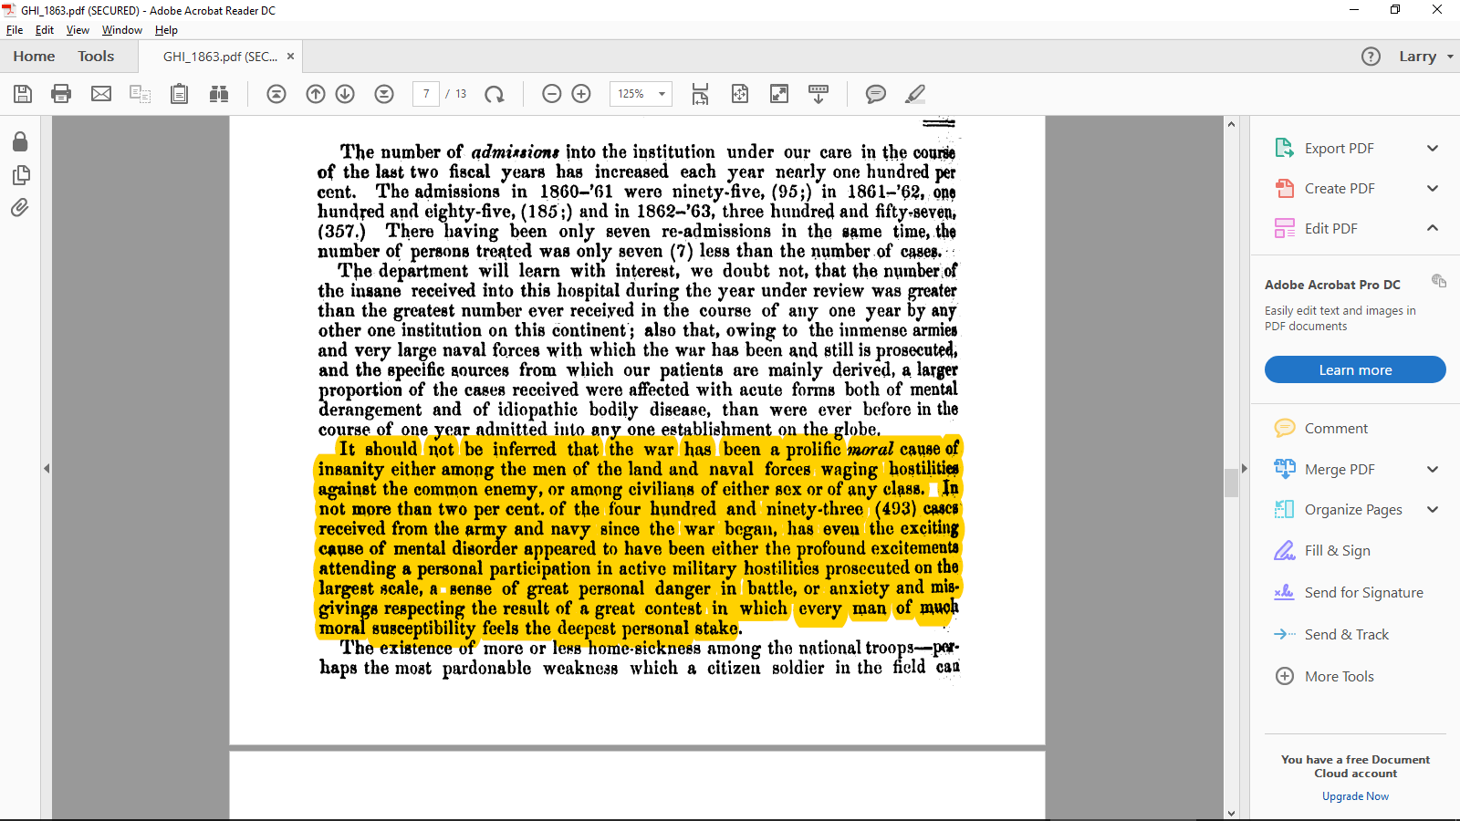

Slide 25
Isaac H. Stearns
Isaac H. Stearns

Slide 26
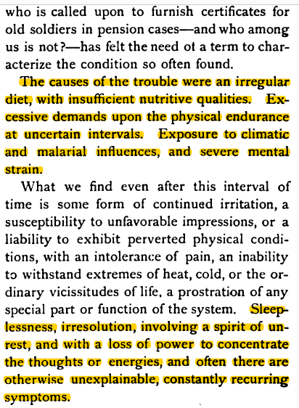
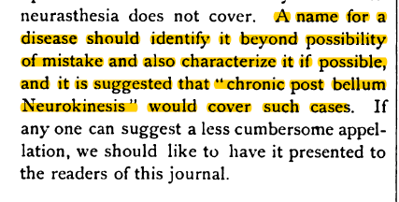

Slide 27
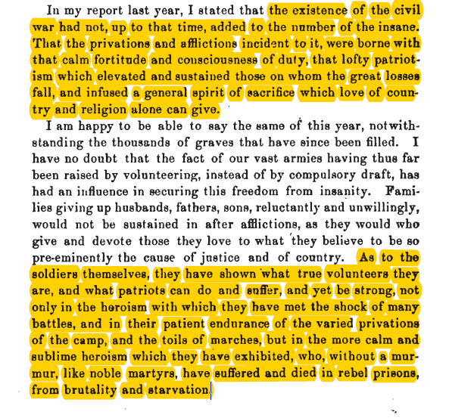

Slide 28
African-American men reported as “insane,” 1880 U.S. Censusn reported as “insane,” 1880 U.S. Census
Table 5: African-American men reported as “insane,” 1880 U.S. Censusn reported as “insane,” 1880 U.S. Census
 | Number insane per 10,000
Veterans in EI Colored Troops II sample¹ | 17
All black men 30-60² | 20
¹Dora L. Costa et al., The Aging of US Colored Troops [machine-readable database] (Chicago: Center for Population Economics, University of Chicago, 2015).
²Steven Ruggles et al., Integrated Public Use Microdata Series: Version 6.0 [machine-readable database] (Minneapolis: University of Minnesota, 2015). Rates adjusted for age distributions.

Slide 29
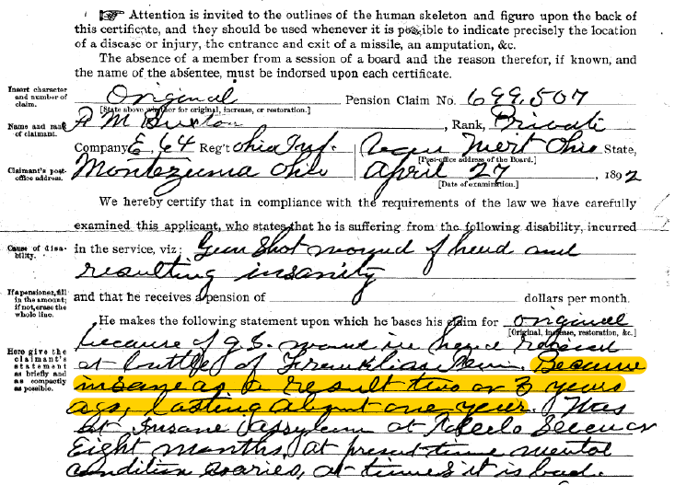

Slide 30
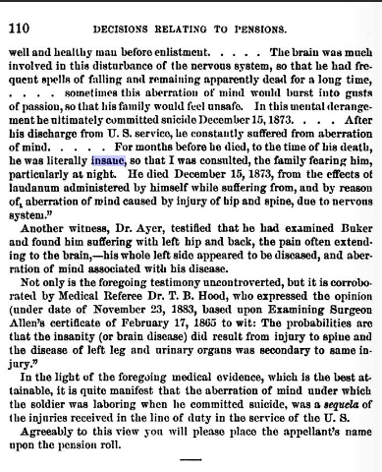
Decisions related to pensions

Slide 31
